Slide 1

Grower’s Nation
Planting seeds locally for a more sustainable future.

Slide 2
Grower’s Nation
The result of a dedicated team who are passionate about exploring the potential of unused land for the growing of fruit, vegetable and other crops.
The app (currently in prototype phase) has been designed to reduce the barriers to growing by taking location, climate and growing data into consideration and to give more people the information they need when selecting what to grow.
Collaborating with teams from Exeter, San Francisco, New York City, Chile, Nairobi and the Dominican Republic, work began on developing the app, a user interface and collating the many sets of data needed to get the project up and running.

Slide 3
Grower's Nation
The User Interface Design

Slide 4
User Stories
Gardener
Teacher
Farmer

Slide 5
As a gardener
I want to know when to grow a particular crop at my location.

Slide 6
As a farmer / teacher
I want to know what will grow successfully at my location.

Slide 7
As a gardener
I want to know where I can grow plants locally.
As a land owner
I want to know who can help grow produce on my land.
Link to Land share.

Slide 8
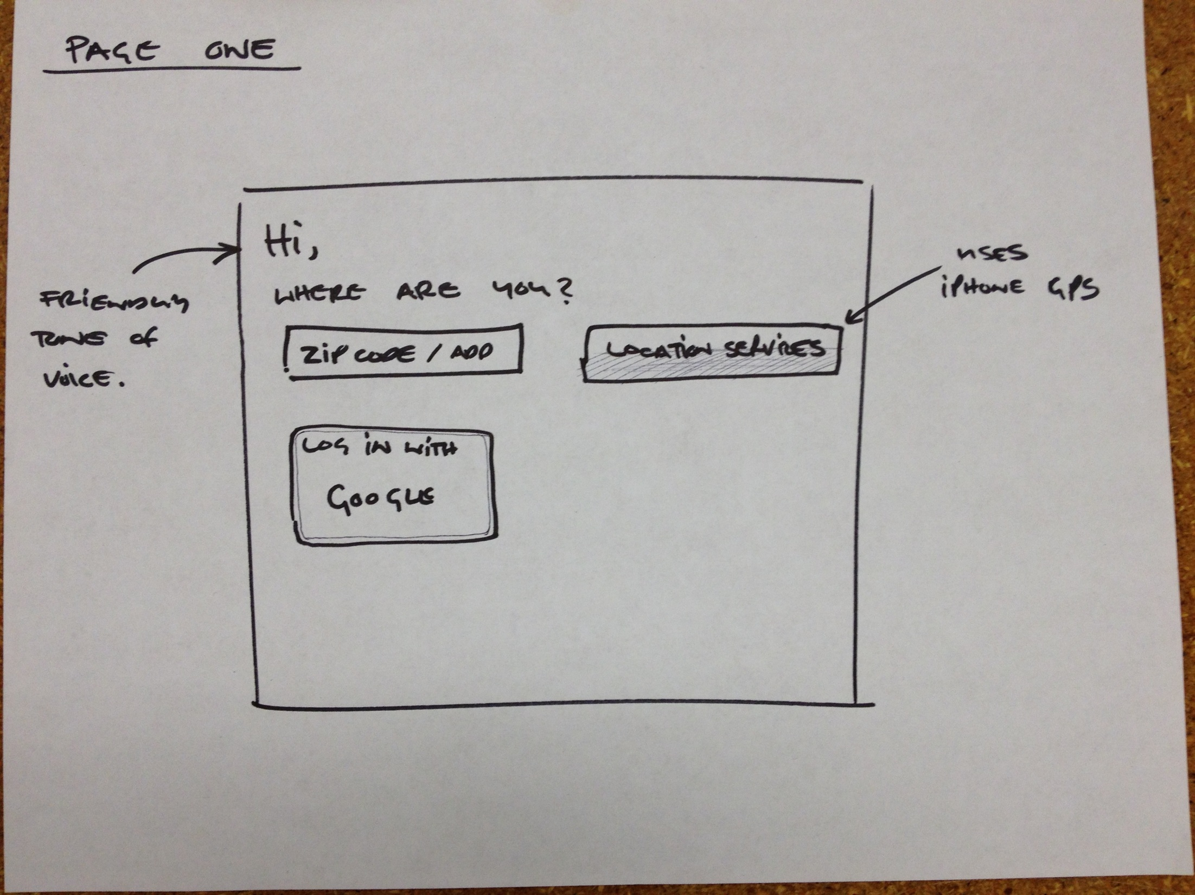

Slide 9
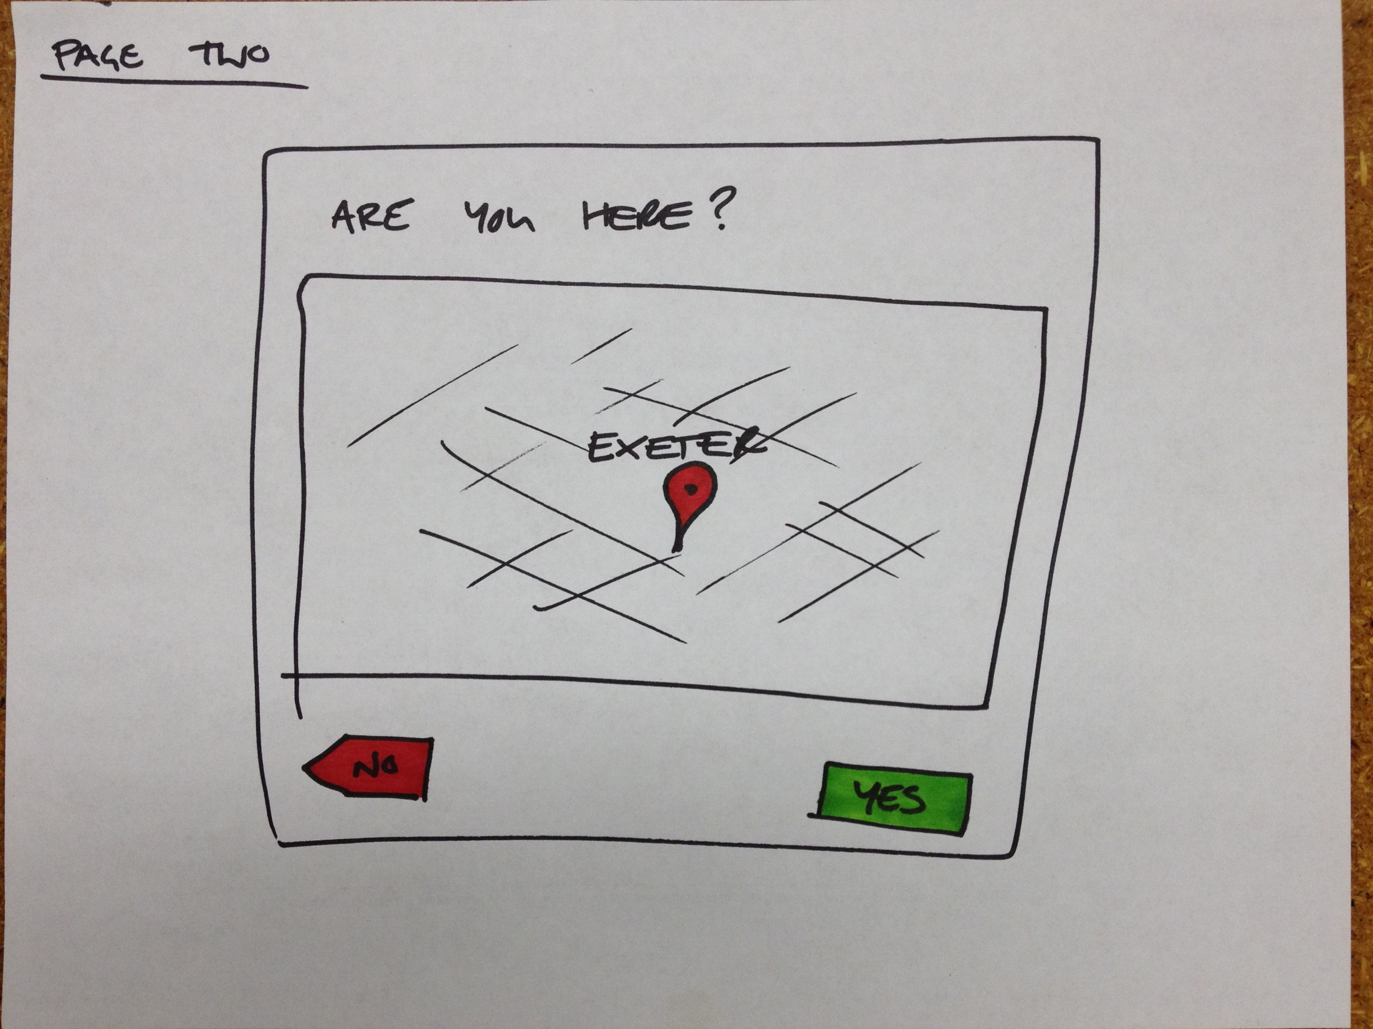

Slide 10
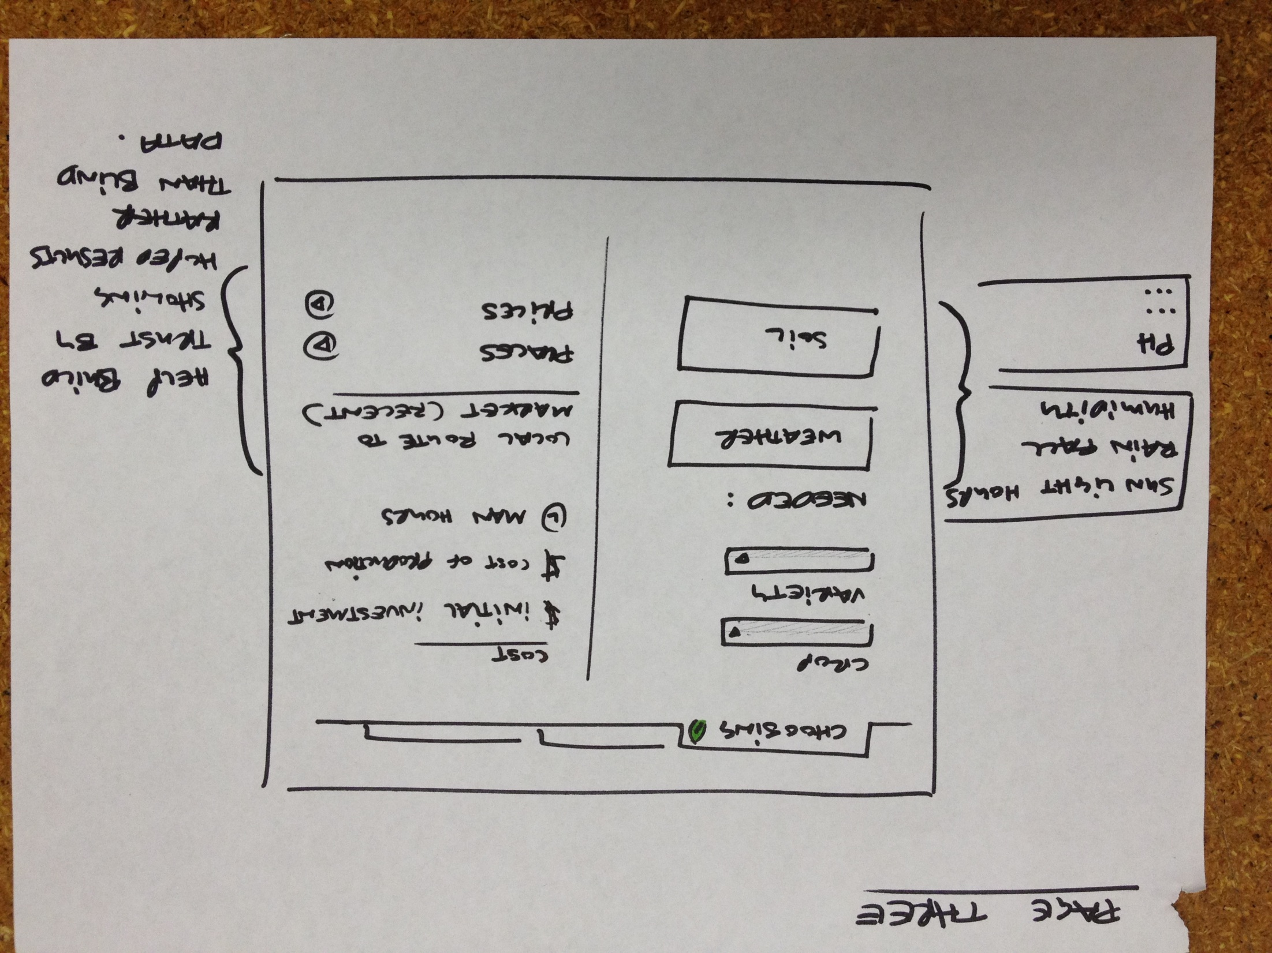

Slide 11
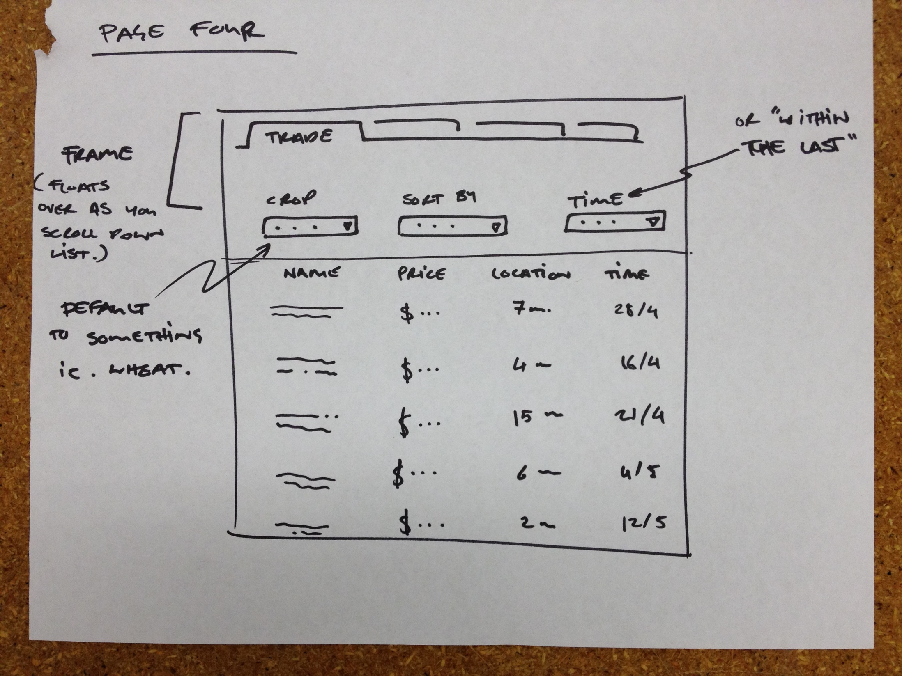

Slide 12
Grower's Nation
Developing the Software

Slide 13
Developing the software
User Centric Design
jQuery
jQuery Mobile
LAMP
  Linux
  Apache
  MySQL
  PHP
Google Maps V3
Red Bull

Slide 14
The prototype

Slide 15
Now get growing!

